Slide 1
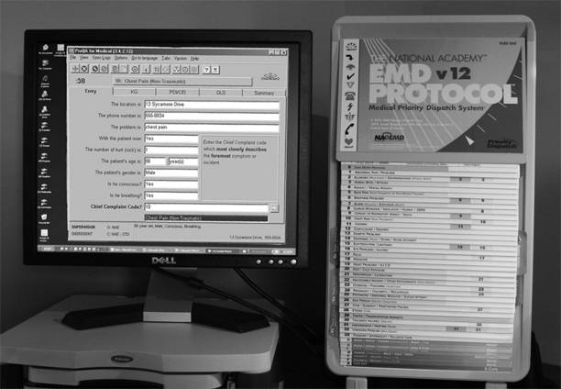
Introduction To The MPDS Coding System
Notes:
Suggested instructional time for this lesson: 3-4 hours
Introduction:
This Training Module provides an introduction to the MPDS Coding System. It explains the purpose and use of the “dispatch codes.” This Training Module is limited to only the MPDS coding system. It should be taught by EMDs or EMD-Qs who are “MPDS literate.”

Slide 2
What is the MPDS Dispatch Code?
A Pre-Planned Response Selection/Mode Tool
A Communications Tool
An EMD Protocol Compliance Evaluation Tool
An EMS Response Frequency/Urgency Quantification Tool
An EMS Efficiency/Effectiveness Tool
A Research Tool
Notes:
*The MPDS anticipates that local EMS response policy planners (i.e. police chief, fire chief, ambulance service chief, volunteer chief, 9-1-1 director), as a group, will marry a pre-planned response (ALS, BLS or both) and mode (emergency or non-emergency) to every dispatch code in the protocol set.
*The dispatch code communicates to EMS responders the chief complaint and the level of urgency of the response in a concise way.
*The dispatch code allows medical dispatch case reviewers to objectively determine if the EMD actively listened to the answers to the questions asked and acted on the answers appropriately. If the EMD doesn’t pay close attention to the answers to the questions asked he/she will not code the case correctly.
*Local EMS managers can use MPDS coding data to determine the frequency and urgency level of the chief complaints in the protocol set.
*Retrospective comparison of MPDS coding data with EMS pre-hospital patient care records can assist local response planners in determining whether pre-planned responses are correct (i.e. over triage or under triage … sending too much or not enough).
*MPDS coding data provides for clinical research into how patients with specific chief complaints manifest specific priority symptoms at the point of contact with the emergency care system. In addition, the coding system provides for comparative studies between EMS jurisdictions, between states and between countries.

Slide 3
Primary MPDS Dispatch Objectives
Provide for the safety of patients, responders and bystanders
Send the correct response in the right way
Tell the 9-1-1 caller what to do for the patient prior to the arrival of the responders
Provide EMS responders with “news they can use.”
Notes:
This slide explains the reasons for the questions that the EMD asks the 9-1-1 EMS caller.

Slide 4
“Any true or actual medical emergency, as it worsens, will result in one or more of 4 basic priority symptoms: chest pain; difficulty breathing; change in level of consciousness; serious hemorrhage … in all cases, no exceptions.”
The EMD’s job is to interrogate about the presence or absence of priority symptoms.
Notes:
Priority Symptoms:
Diagnosis is one of the most complex tasks in medicine. Only physicians, nurse practitioners and physician assistants (under the supervision of an M.D.) are allowed to diagnose a medical complaint. Historically, 9-1-1 call-takers have wasted time trying to determine the cause of a caller’s chief complaint. This has resulted in significant delays in the dispatch of EMS resources and major law suits.
Given a specific chief complaint, EMD’s are trained to interrogate about the presence or absence of 4 basic priority symptoms. Priority symptoms are easily recognized by both first and second party 9-1-1. Neither callers or EMDs are diagnosticians.
The search for the presence or absence of priority symptoms provides a consistent, structured interrogation by the EMD. In the absence of this medically appropriate approach 9-1-1 call-takers “re-invent the interrogation wheel every time they answer the phone.”

Slide 5
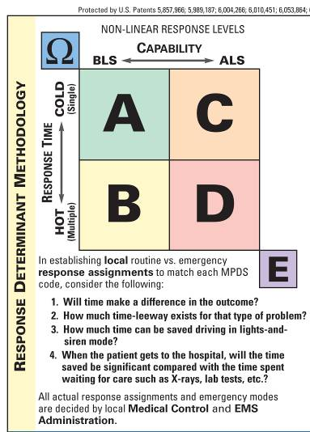
Pre-Planned Response/Mode Selection
E Edward level
D David level
C Charles level
B Boy level
A Adam level
Ω Omega
Notes:
Response Determinant Levels:
As you move across the table you’re moving from BLS (1st Responders, EMTs) to ALS (Paramedics, EMT Intermediates) level dispatches. In the generic system Alphas and Bravos are BLS level responses; Charles and Deltas are ALS level dispatches. As you move down the chart vertically you’re moving from “cold” (non-emergency) responses to “hot” (emergency) responses. Echo level responses are immediate, maximal responses for extreme conditions of breathing (respiratory arrest or ineffective breathing). Omega level responses are non-emergency referrals or alternative transport modes for EMS calls that should not require the dispatch of emergency resources.
The system envisions that local public safety managers (police chief, fire chief, ambulance service chief, volunteer fire & EMS chiefs, the 9-1-1 director and the local EMS medical director), as a group and based on local resource inventory, will pre-plan responses and modes for every MPDS code.
Key Teaching Point: Emphasize the Response assignments are locally determined.
Key Teaching Point: The coding system provides a framework to match the level of response to the level of urgency as determined by the EMD
Key Teaching Point: 95% of all EMS calls are not time-critical or life-threatening.
OMEGA Audio Tape (1:43) - Rat Poison
This is an illustration of the Poison Control Center referral associated with the OMEGA determinant level on Protocol 23. This Omega determinant code utilizes an alternative community resource for a 9-1-1 call that should not require the dispatch of a mobile EMS response. Refer participants to Rule 1 in the Additional Information section of Protocol 23 before playing the tape.

Slide 6
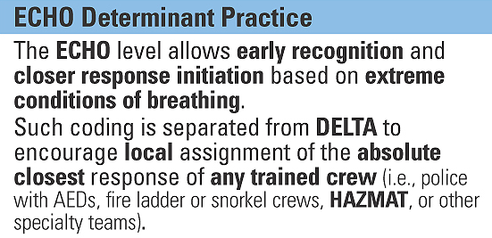
E Edward Determinant Philosophy
E Edward
In certain life-threatening situations, you can dispatch early in the interrogation sequence.
D David to
ECHO provides a means for assigning response-capable units that would not normally respond to typical EMS Calls.
Notes:
ECHO Determinant Coding:
The ECHO determinant level provides a means early recognition of extreme conditions of breathing by the EMD and allows local response policy planners to pre-plan the response of “the closest anything” if it can help in extreme conditions of breathing. ECHO level responses are dispatched by the EMD within the first 20-30 seconds of caller interrogation.

Slide 7
Case Entry Protocol
The Four Commandments:
Chief Complaint
Age
Status of Consciousness
Status of Breathing
Notes:
After eliciting and verifying the address of the emergency and the number the 9-1-1 caller is calling from the EMD interrogates for “Four Commandment” information. If the answer to the Case Entry breathing question is “no,” “I can’t tell,” or “I’m not sure” a maximal emergency response is dispatched immediately. If the 9-1-1 caller reports that the patient is breathing, but is not awake, thirty seconds of further interrogation occurs on the appropriate chief complaint interrogation protocol. Patients who are not awake generate a Delta level dispatch.

Slide 8
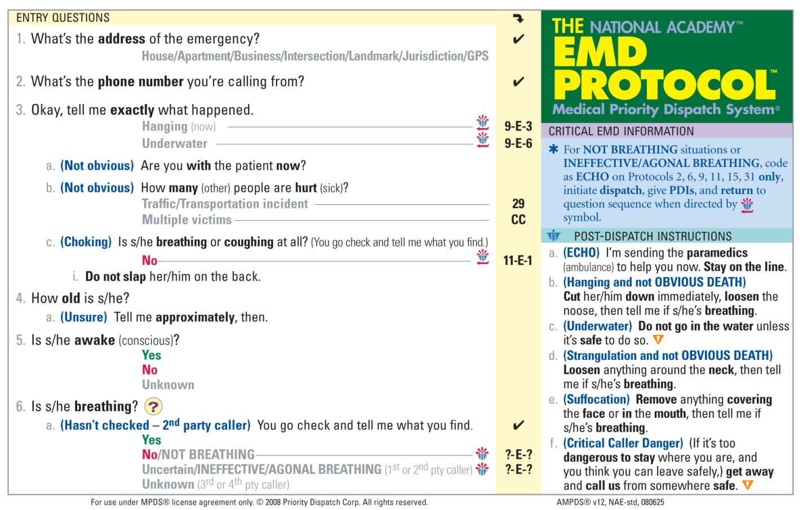
Case Entry “Road Signs”
Notes:
Immediate ECHO dispatch symbols:
Direct the students’ attention to the symbols (sometimes referred to as “road signs”) on the Case Entry Protocol. The Case Entry Protocol is where the EMD’s interrogation starts. The symbols that trigger an immediate ECHO dispatch are when a patient is hanging, patient underwater, choking, not breathing or breathing “ineffectively.” In hanging, patient underwater, and choking situations after the EMD dispatches an immediate response. After dispatching the immediate response, the EMD returns to the Case Entry protocol and continues the interrogation to determine which Pre-Arrival Instruction Protocol is appropriate for the situation. Except for Emergency Childbirth and Delivery situations Pre-Arrival Instruction Protocol selection is based on the patient’s age.
If the EMD determines during Case Entry interrogation that the patient is breathing medical dispatch philosophy holds that there is an additional thirty seconds to ask a few more questions so the correct level of EMS response can be dispatched either emergency or non-emergency.

Slide 9
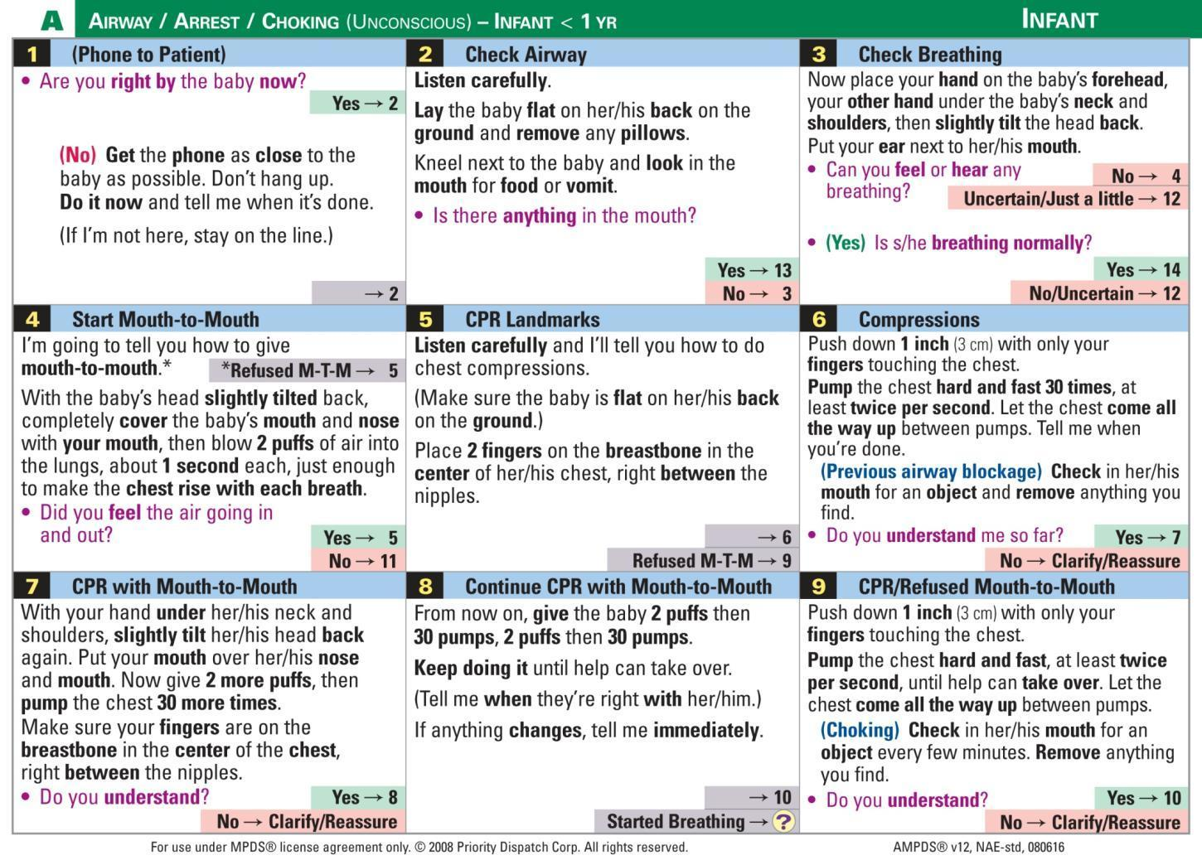
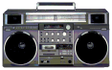
Notes:
Protocol A Airway / Arrest / Choking (Unconscious) - Infant < 1 Yr
As the tape plays the trainer can point to the pre-arrival instruction panels that the EMD is reading.

Slide 10
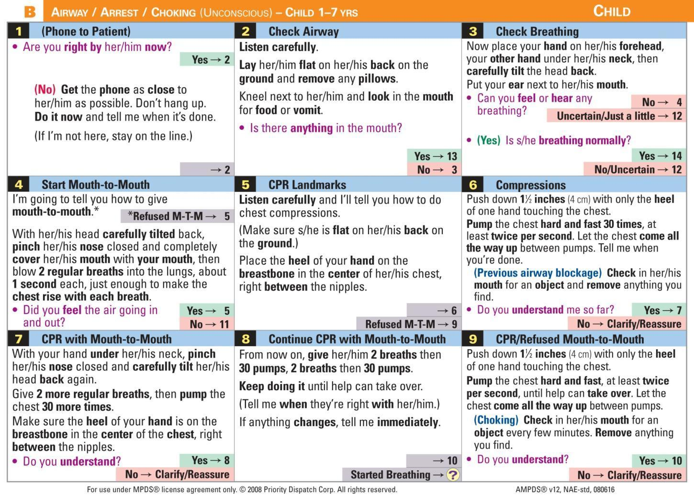
Notes:
Protocol B Airway / Arrest / Choking (Unconscious) - Child 1-7 Yrs

Slide 11
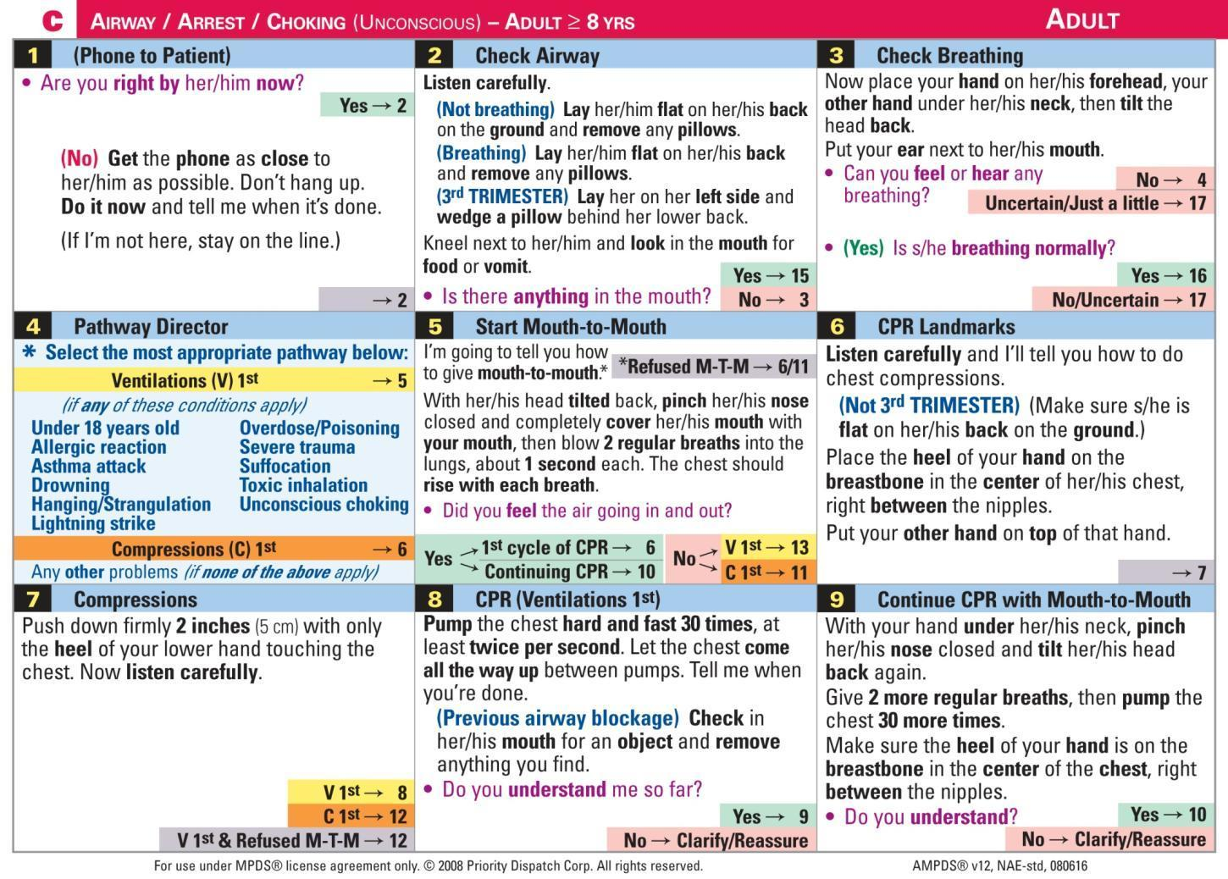

Notes:
Protocol C Airway / Arrest / Choking (Unconscious) - Adult ≥ 8 Yrs
Use this slide to demonstrate the ProQA. Pause the video to point out that the dispatch is made within 46 seconds of the receipt of the 9-1-1 call.

Slide 12
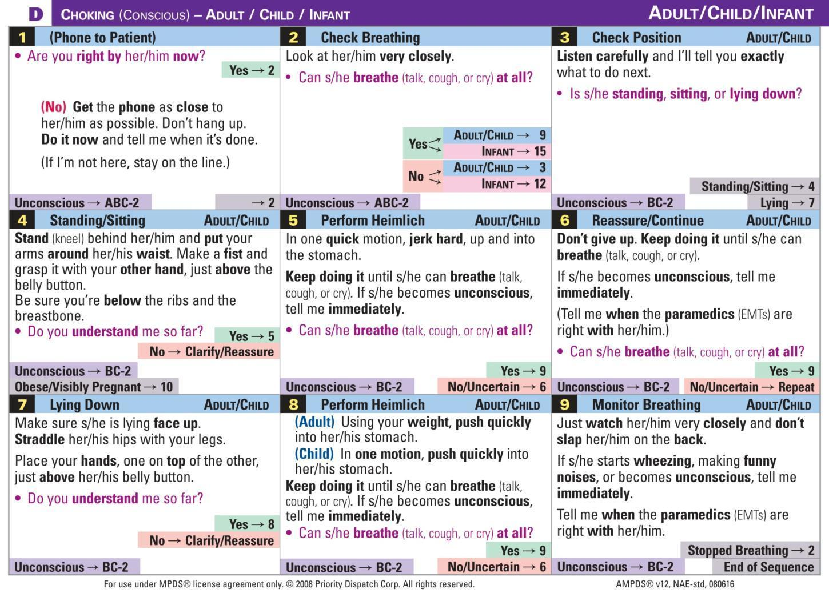
Notes:
Protocol D Choking (Conscious) – Adult / Child / Infant
Using the red boxes follow the pathway for Adult/Child complete obstruction.
Point out color coding and directors that distinguish Infant from Child panels.

Slide 13
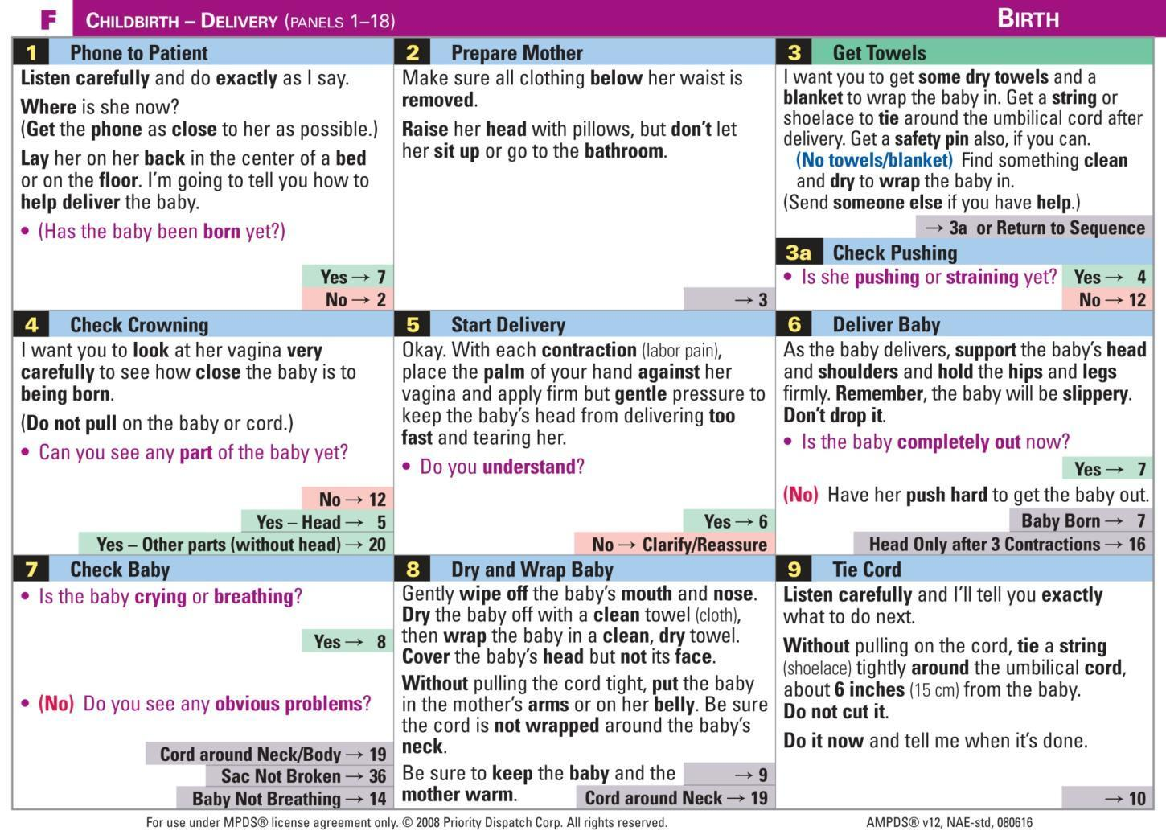
Notes:
Protocol F Childbirth - Delivery
Using Protocol F the EMD guides the caller through the childbirth process to ensure a safe delivery. Protocol F also includes instruction panels for breech delivery and breech positioning when a safe breech delivery is not possible. It also includes instruction panels for shoulder dystocia, nuchal/body cord, ruptured cord, post-partum hemorrhage, and amniotic sac not broken.

Slide 14
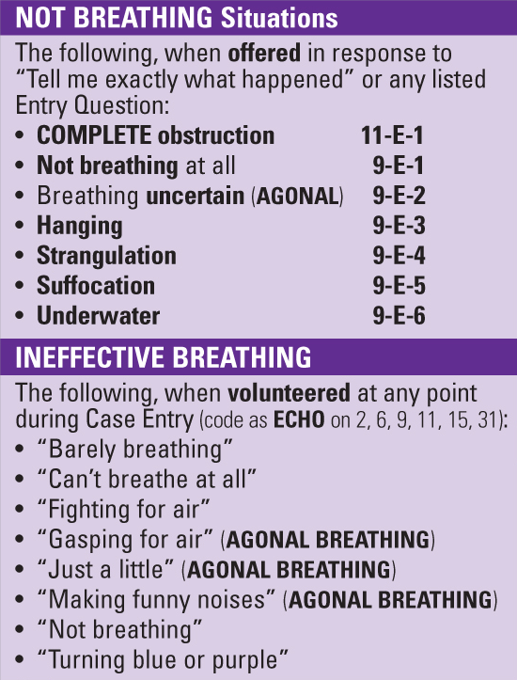
E Edward MPDS Dispatch Codes
Found on the Case Entry Additional Information Protocol.
E
Notes:
ECHO Determinant Codes
The Additional Information Section of the Case Entry Protocol defines NOT BREATHING and INEFFECTIVE BREATHING situations for the EMD. Whenever a caller tells the EMD that the patient is not breathing or the caller makes an “ineffective breathing statement” the EMD tells the caller, “Stay on the line, I’m sending help.
6 protocols have an ECHO determinant level. Except for Protocol 9, ECHO is limited to only one dispatch code (?-E-1) per protocol. Explain that a response is only coded as an ECHO for immediate dispatches out of Case Entry. Direct the students’ attention to each of the “purple-tabbed” protocols. Note that except for Protocol 9, the dispatch code for each purple-tabbed protocol is “ECHO-1” (2-E-1, 6-E-1, 11-E-1, 15-E-1 and 31-E-1). This simplifies ECHO coding for the EMD.

Slide 15
Chief Complaint Interrogation Protocols
Medical dispatch theory holds that if the answer to the Case Entry breathing question is “yes” we’ve bought 30 more seconds to ask a few more questions, related to the chief complaint, so we can send “the right thing in the right way” and tell the caller what to do before the responders arrive.
Notes:
Use this slide to address the issue that the EMD interrogation “takes too long.” The protocols are designed to be accomplished in 60 seconds or less. In the worst of cases the dispatch is made within the first 20-30 seconds of the 9-1-1 call.

Slide 16
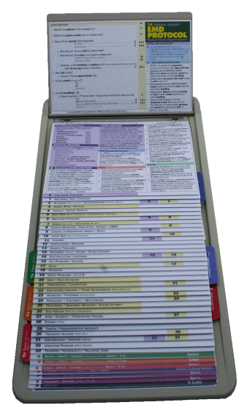
Protocol Overview
Case Entry Protocol
Case Entry Additional Information Protocol
Aspirin Diagnostic and Instruction Tool
*
*
Chief Complaint Protocols (1-33)
*
*
*
Pre-Arrival Protocols
(*includes Y, Z, & Sinking Vehicle tabs)
Case Exit Protocol
Notes:
Protocol Overview
Hand out the protocols. Briefly overview the protocol set by showing the students the four primary components:
Case Entry
Chief Complaint Protocols
Pre-Arrival Protocols
Case Exit Protocol

Slide 17
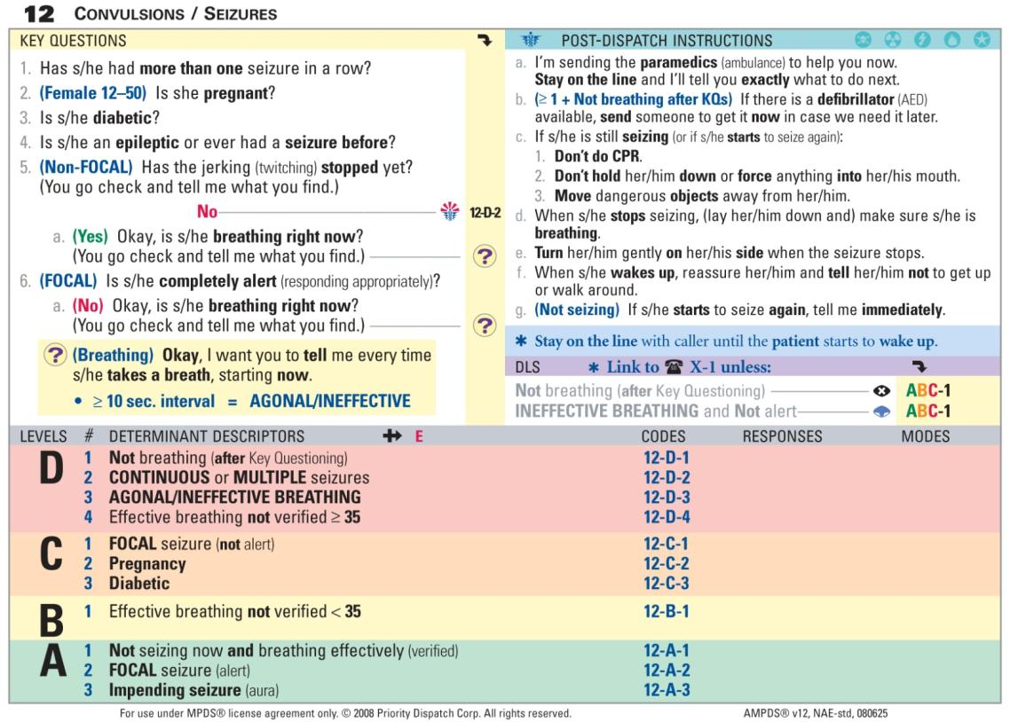
The User-Defined Section of the Protocol
Determinant Levels & Descriptors
Notes:
TP: This section of the protocol is the “user-defined” section of the protocol. The system envisions that local response policy planners will “marry” a pre-planned response (BLS, ALS or both) and mode (hot or cold) to every dispatch code in the Protocol set. The wide colored bands with the big letters on the left are “Determinant Levels.” The determinant levels are hierarchical in reverse order.
.

Slide 18
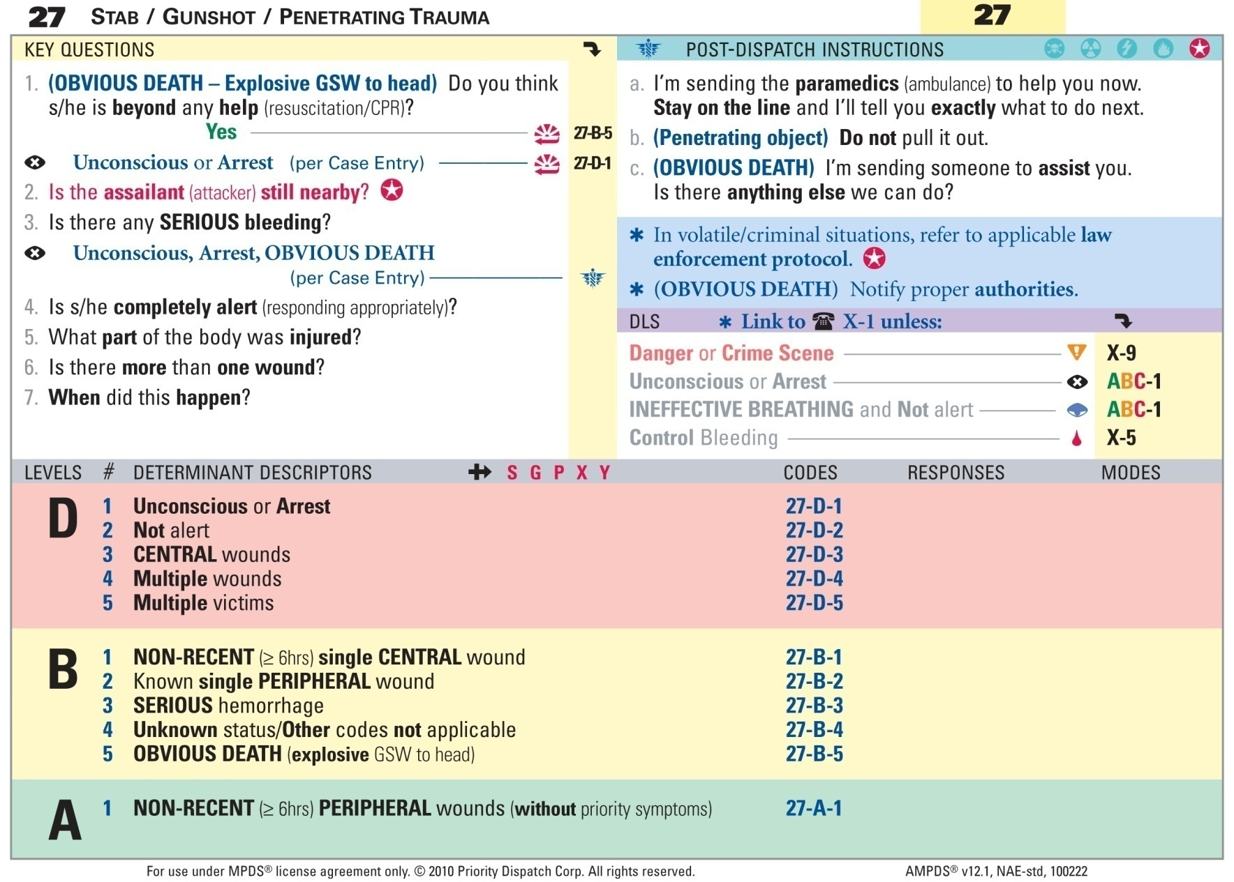
Determinant Descriptors
Notes:
Determinant Descriptors
Each determinant descriptor relates directly to a key question asked by the EMD on a particular protocol. Key questions are designed to elicit yes or no answer from the caller.

Slide 19
Determinant Descriptors
With the information obtained during Key Question Interrogation, the EMD selects the most appropriate Determinant Descriptor.
Determinants are divided into Determinant Levels and Determinant Descriptors. Some protocols contain a suffix that is added to the Protocol number and the highest determinant level and descriptor that applies to the EMD’s interrogation. Together they form a dispatch code.
Notes:
Determinant descriptors are the numbers followed by words within each determinant level. Each determinant descriptor relates directly to a key question that is asked on a particular protocol. This slide sets the stage for the exercise contained in the next slide.

Slide 20
How does the EMD determine the “dispatch code.”
The “dispatch code” is a combination of the Protocol’s number and the highest determinant level and descriptor that applies. Some protocols have a suffix that is appended to the end of the code to further define the nature of the response.
Notes:
This slide sets the stage for the next slide.

Slide 21
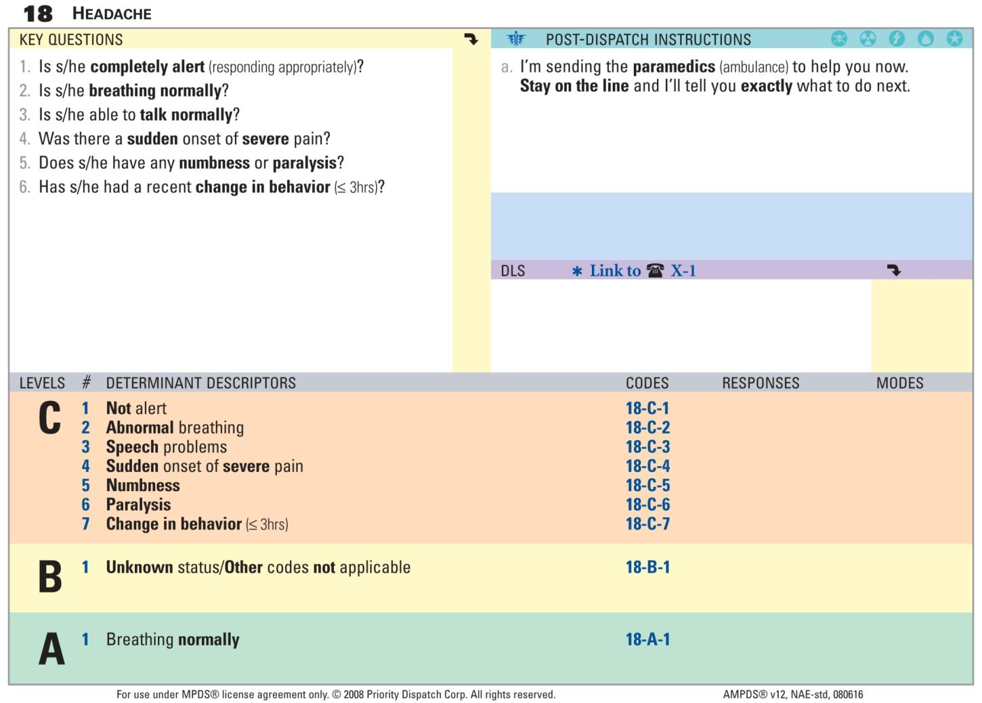
Notes:
Take the participants through a simulated 9-1-1 call where a second party caller says that his 42 year old wife has a bad headache. During Case Entry the caller says that his wife is awake and is breathing. The interrogation then continues on Protocol 18.
Is she completely alert? Yes
Is she breathing normally? Yes
Is she able to talk normally? No … I can hardly understand her.
Was there a sudden onset of severe pain? I don’t know.
Does she have any numbness or paralysis? No
Has she had a recent change in behavior? No
Point out that the highest determinant level and descriptor that applies is the C-3 descriptor and the resulting dispatch code is 18-C-3.

Slide 22
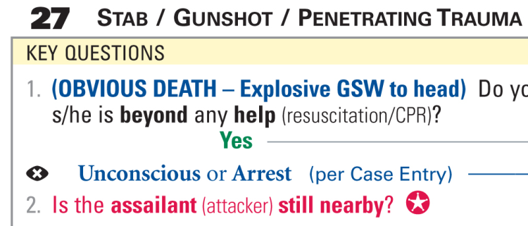
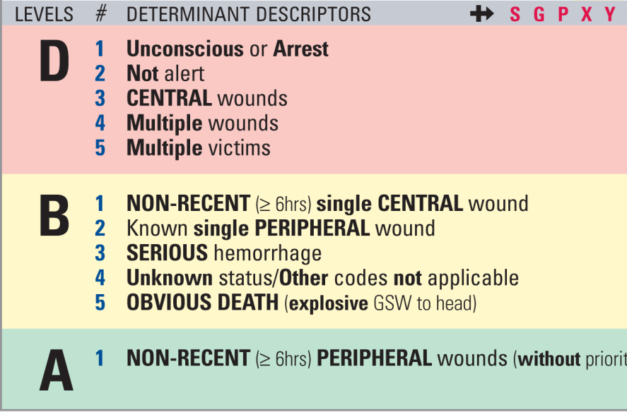
Determinant Coding Exercise
Formula:
Chief Complaint Protocol number
+ Determinant level
+ Determinant Descriptor number
+ Suffix (if applicable)
= Determinant Code
27
- D
- 4
- S
Notes:
This simulated call demonstrates the use of a suffix. Direct the students’ attention to Protocol 27. Take them through the following scenario starting from Case Entry:
Okay, tell me exactly what happened. We have a man here that has been stabbed.
Are you with him now? Yes
How many other people are hurt? Just him.
How old is he? 23
Is he awake? Yes
Is he breathing? Yes
Since the chief complaint is a stabbing and the patient is breathing we interrogate on Protocol 27.
Is the assailant still nearby? No, he’s gone.
Is there any serious bleeding? Not that I can see.
Is he completely alert? Yes
What part of the body is injured? He got stabbed in his left lower leg.
Is there more than one wound? Yes
When did this happen? Just a few minutes ago.
“I’m sending the paramedics to help you now. Stay on the line and I’ll tell you exactly what to do”
Walk the students through how the call is coded:
What is the number of the protocol were interrogating on? 27
What is the highest determinant level and descriptor that applies? D-4
What is the appropriate suffix? S

Slide 23

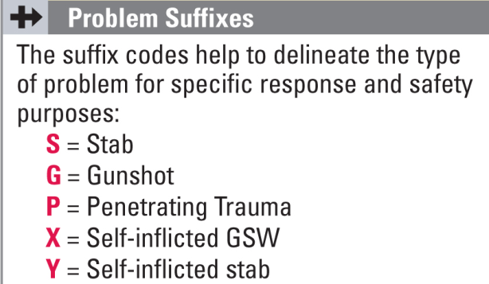
Problem Suffixes
Add Suffix
Notes:
Problem Suffixes
Explain what suffixes are and the location of them on the Chief Complaint Protocol card, along with the Add Suffix Symbol. Also explain the location of the explanation of the codes found on the Additional Information Protocol.

Slide 24
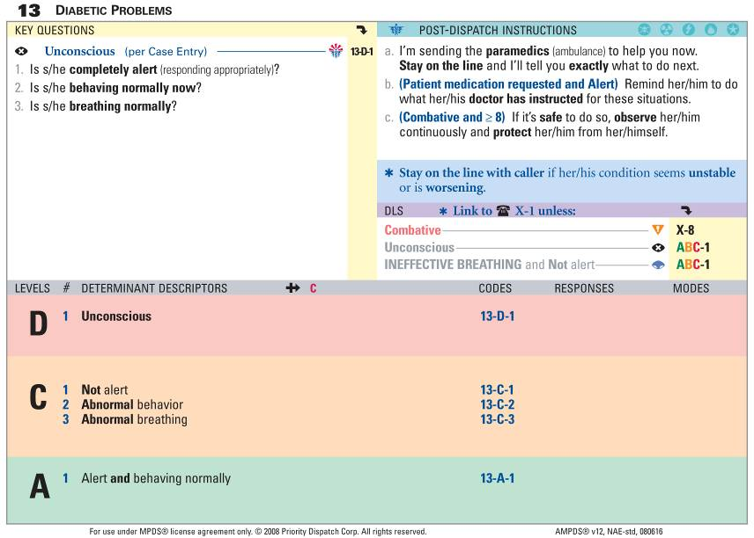
Protocol Pathway
#4-Provide PDIs
#1-Ask all KQs
#5-Read EMD Information
#6-Follow DLS Links
1st Responder HOT
ALS HOT
#2-Select code
#3-Send response
ALS COLD
ALS COLD
ALS HOT
BLS Ambulance COLD
Notes:
Protocol Pathway
This slide demonstrates how the EMD progresses through the protocol.
All key questions are asked (unless the answer is obvious or the answer has been spontaneously volunteered by the caller.
Based on the caller’s answers to the key questions the EMD selects the correct dispatch code.
The pre-planned response for the dispatch code is dispatched
After the pre-planned response is dispatched the Post-Dispatch Instructions that are appropriate and possible are provided to the caller.
The EMD then reads the Critical EMD Information (it is not read to the caller).
The EMD then follows any applicable Dispatch Life Support (DLS) links that apply to either Pre-arrival Instructions or Case Exit.
Direct the students’ attention to the different pre-planned responses for the 13-D-1 code vs the 13-A-1 dispatch code.

Slide 25
The MPDS Dispatch Code
The dispatch code provides responders with the essential information needed in the initial dispatch:
The dispatch code provides responders with the nature and urgency level of the EMS response.
Additional “plain language” information can be provided to responders when en route.
Notes:
The rationale for the dispatch code is provided in this slide and sets the stage for the next slide. Responders are provided with a Field Responders Guide so they can easily interpret the meaning of the dispatch code.

Slide 26
Formula for Making the Dispatch
Response Location +
Four Commandment Info +
Dispatch Code
Notes:
The formula for making the dispatch provides consistency in how EMS dispatches are “toned out.” It makes the dispatch short and concise. EMDs may communicate additional information regarding the response to the responders once they’re en route.

Slide 27
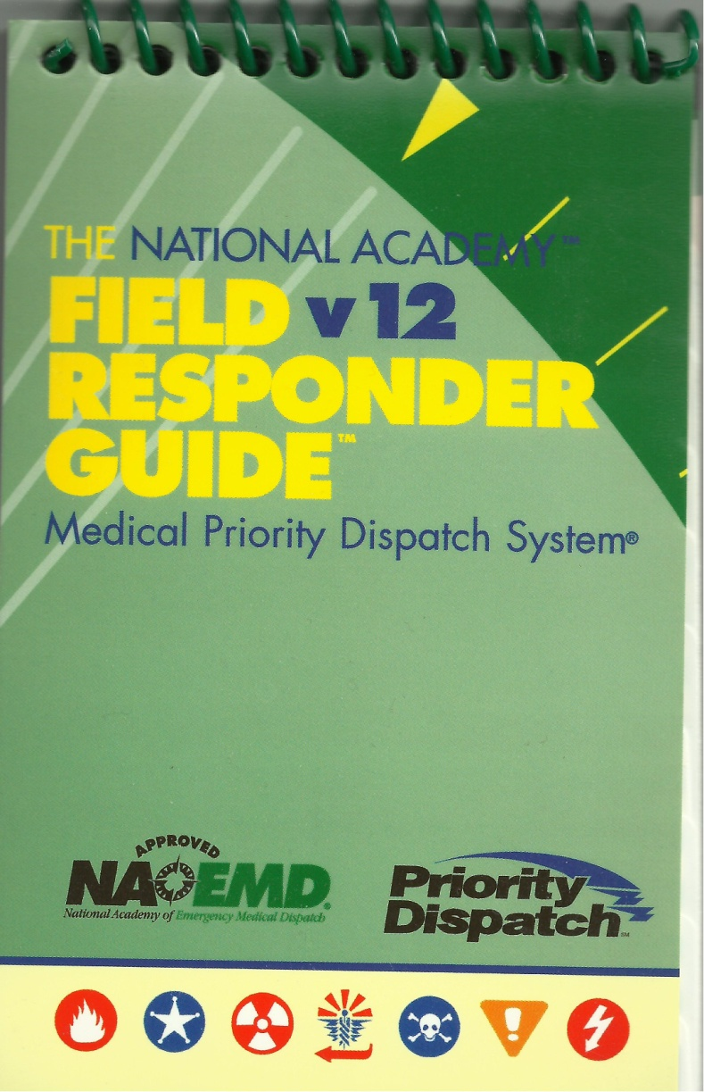
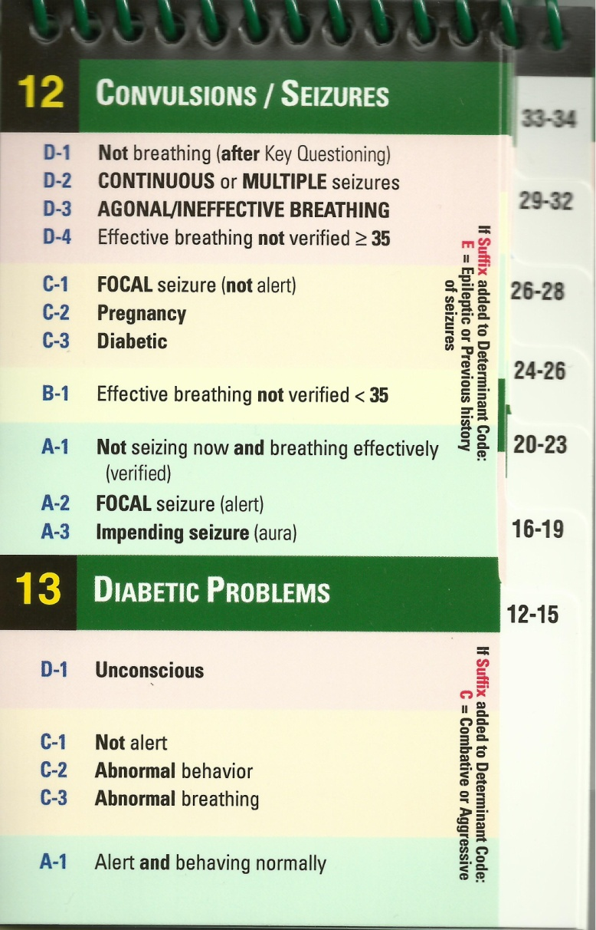
How do responders know what the dispatch code means?
Notes:
EMS responders should be briefed about the EMD program. An overview of the program should be provided and at least two sample dispatches using the protocols should be demonstrated (Protocol 30 and Protocol 13). The responders should then be provided with the Field Responder Guide to be carried on their person or in the emergency vehicle.

Slide 28
How Do EMS Agencies Obtain the
Field Responders Guide?
The Field Responders Guide may be obtained from:
Priority Dispatch Corporation
139 E. South Temple
Salt Lake City, Utah 84111
800-363-9127
or at
www.prioritydispatch.net
*MPDS license number must be provided.

Slide 29
The MPDS Code – an EMD protocol compliance evaluation tool
The dispatch code allows EMD quality assurance case reviewers to objectively determine if the EMD actively listened to the answers to the questions asked.
If the EMD didn’t the case will not be coded correctly.
Notes:
This slide sets the stage for the next slide.

Slide 30
Case Review Feedback
“When performance is measured, performance improves. When performance is measured and reported back to the workers, the rate of improvement accelerates ”
Thomas S. Monson
Universal Course Manual Page 4.5
Notes:
TP: This quote sets up the basis for the next slide. The next slide demonstrates the truthfulness of this quote.

Slide 31
Vancouver, WA Compliance Data Sept/Oct/Nov/Dec 1993
CE
C/C
KQ
PDI
PAI
Sept.
92.3
89.8
65.8
40.8
92.9
Oct.
87.4
87.3
73.4
75.4
95.2
Individual EMD Compliance Feedback Begins
Nov.
97.2
94.9
89.3
93.8
99.0
Dec.
98.6
91.6
96.2
95.8
100.0
Red = NAEMD Accreditation compliance level
Notes:
This data illustrates the power of a quality improvement process and the importance of protocol compliance feedback to EMDs. The September data is protocol compliance data for the 9-1-1 center as a whole after the first month of MPDS implementation.
The October data is protocol compliance data for the 9-1-1 center as a whole after the second month of MPDS implementation. Case Entry protocol compliance has dropped, the correct identification of the chief complaint has dropped. Key question and post-dispatch instruction compliance improved.
At the end of October EMDs started getting feedback about their individual levels of protocol compliance.

Slide 32
The MPDS Code – An EMS Response Frequency/Urgency Quantification Tool
MPDS codes allow 9-1-1 and EMS managers to quantify the EMS response experience more precisely in terms of both frequency and urgency.
The coding system provides for comparative data research between EMS providers from city to city, county to county, state to state, and country to country.

Slide 33
MPDS Quality Improvement
Reduces variance
Ensures compliance
Measures protocol effectiveness
Standardizes the quality of care
Leads to and validates improved resource allocation
Leads to and validates improved response decisions
Ensures scene safety
Reduces litigation risk
Notes:
The Medical Priority Dispatch System is a collection of related entities. The heart of the system is the Protocols. One of the most important components of the system is its prescribed Quality Improvement process. This slide provides the reasons for medical dispatch quality assurance.

Slide 34
The Los Angeles Experience
At the end of the first year of MPDS implementation lights and siren responses were reduced by 60%.
As a result fuel consumption and fleet maintenance costs were reduced by 50%

Slide 35
EMD Resources
Drexell White
National Academies of Emergency Dispatch Web site: www.naemd.org
Priority Dispatch Corp. web site: www.prioritydispatch.net
Fred Hurtado, EMD Consultant fredhurt1@comcast.net
Notes:
EMD Resources.

